Slide 1
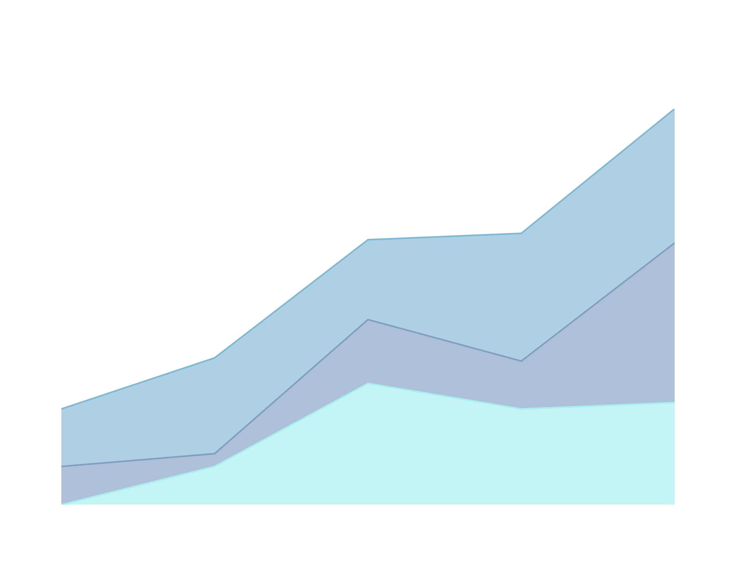

JOB ATTRITION
By: Megan Huy, MSDS Student at Southern Methodist University

Slide 2

Objective
The objective is to provide our stakeholders with meaningful insight into company attrition and support strategies to improve retention and sustain growth.

Slide 3
Data Description
The data set is from the company’s record.
There are 870 employees and 36 variables.
The report shows no missing information.

Slide 4
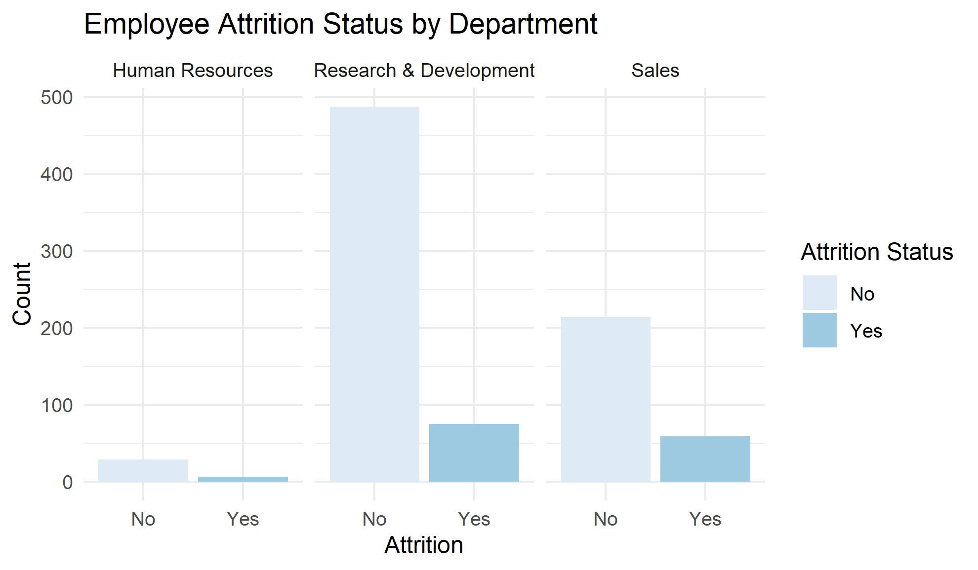
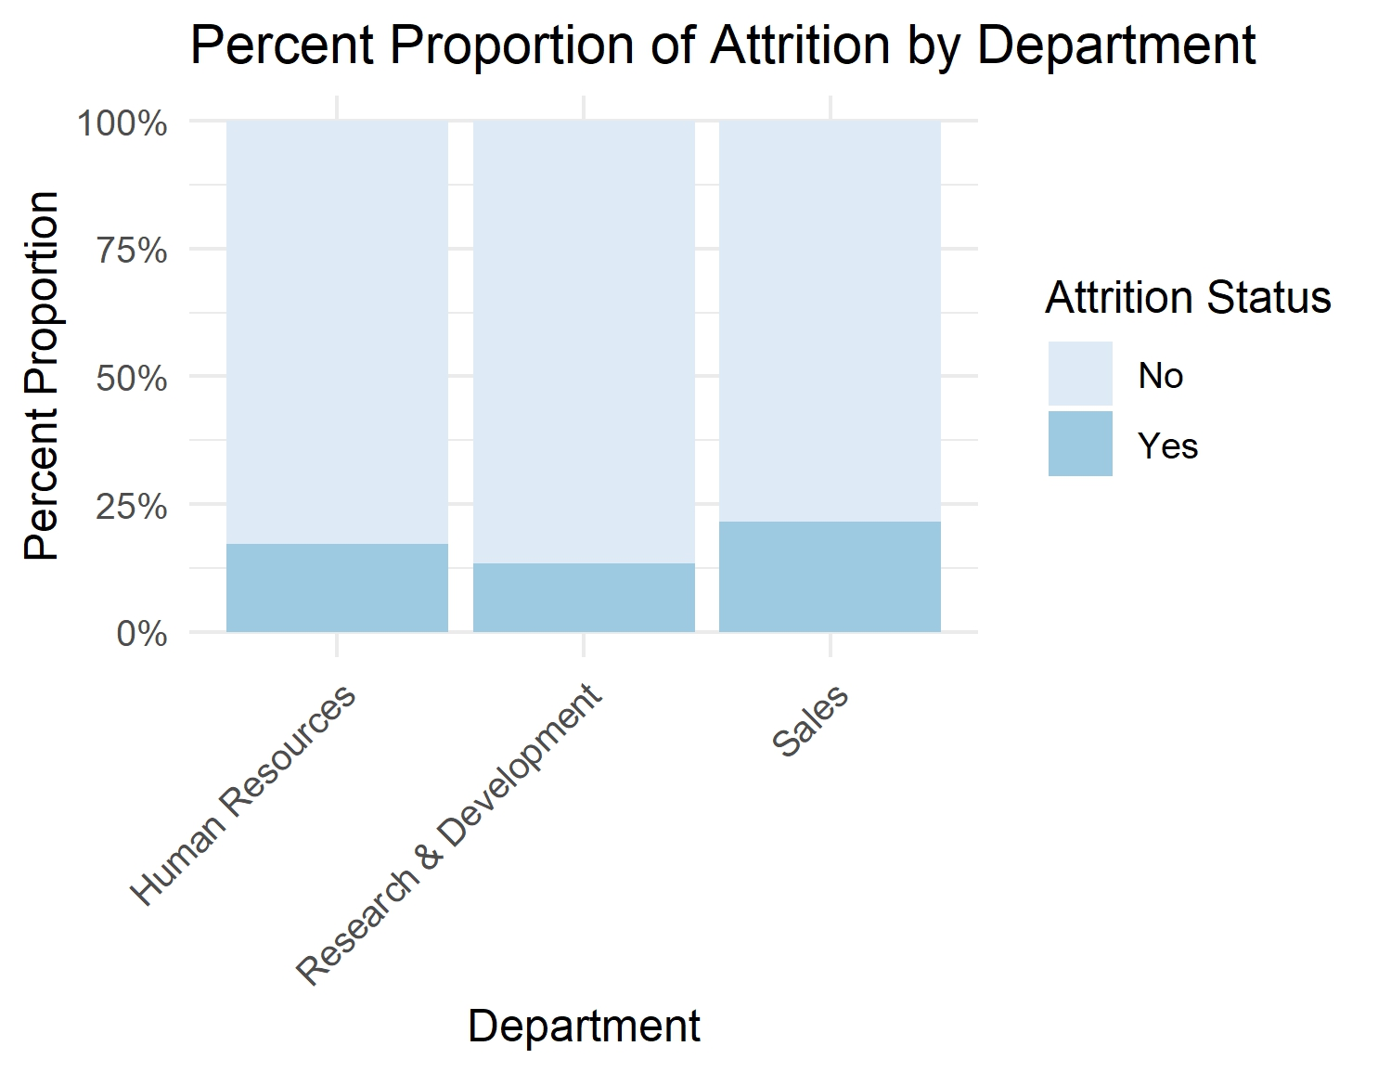
Employee Attrition by Department
No = individuals are currently working at the company
Yes = individuals that left the company
Less than 25% of employees left each department.

Slide 5
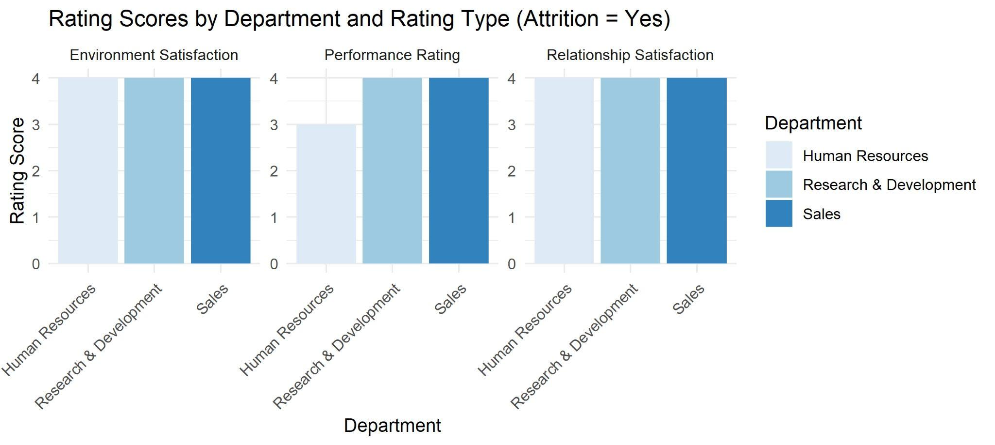
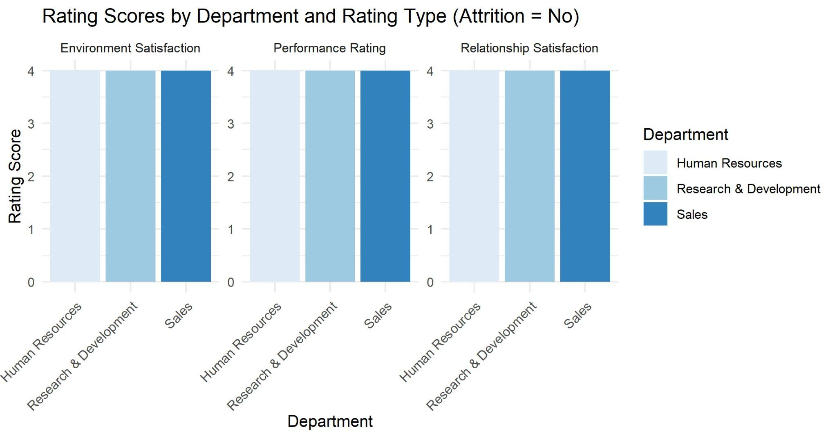
Ratings by Department
High rating scores across all departments, regardless of attrition status.

Slide 6
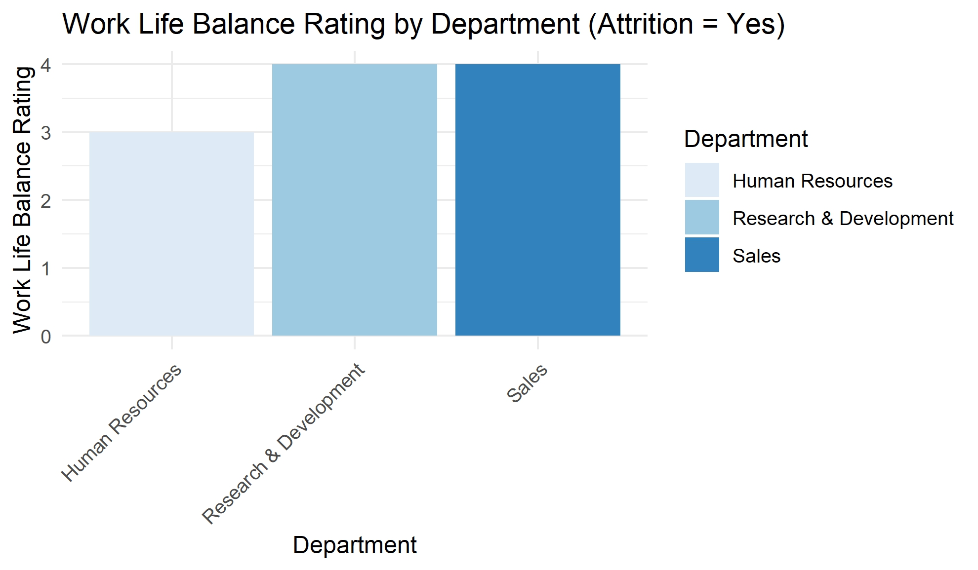
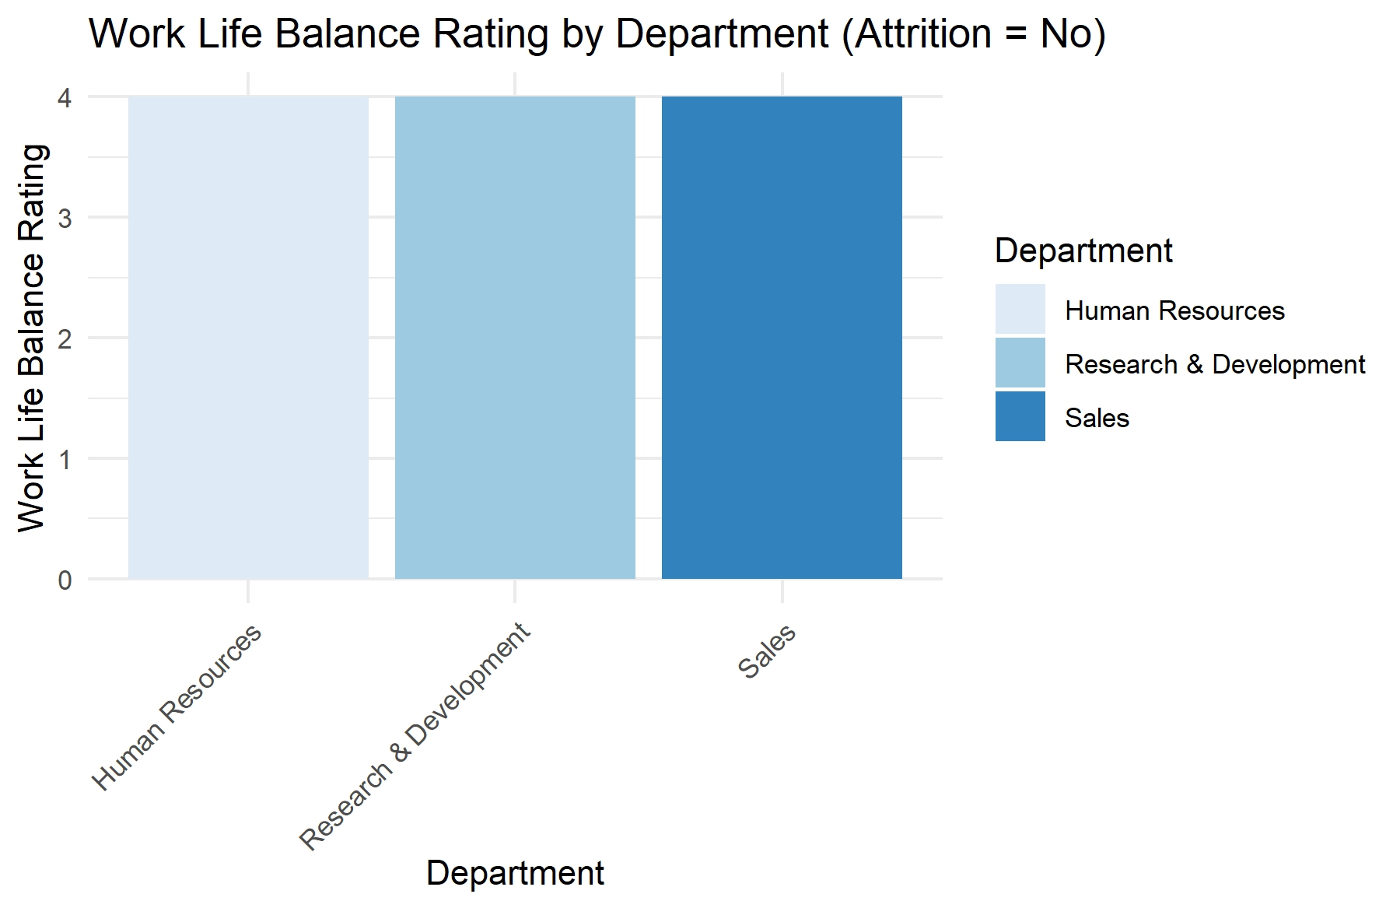
Work Life Balance by Department
High rating scores across all departments, regardless of attrition status.

Slide 7
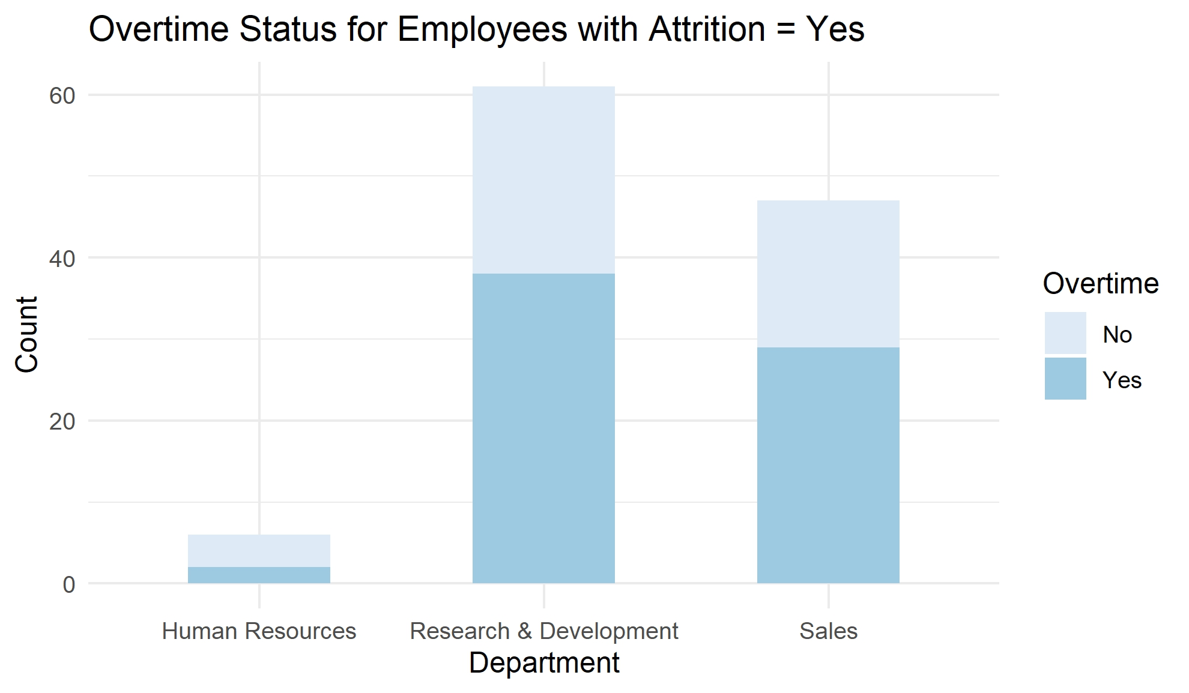
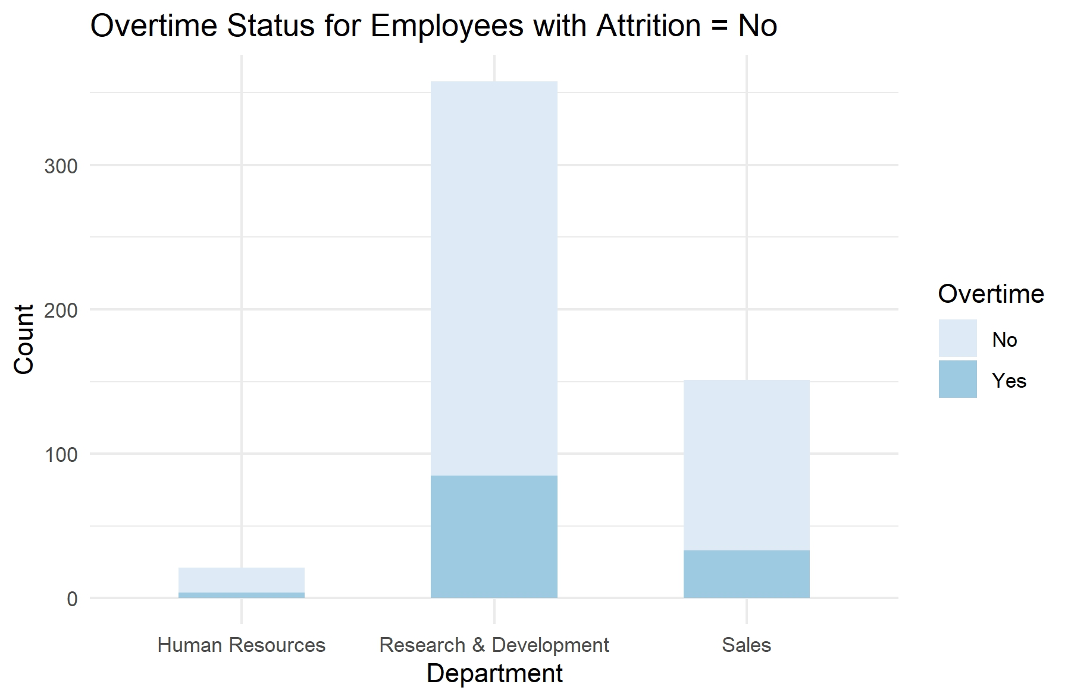
Overtime Status by Department
Majority of employees that left in Research & Development and Sales worked overtime.

Slide 8
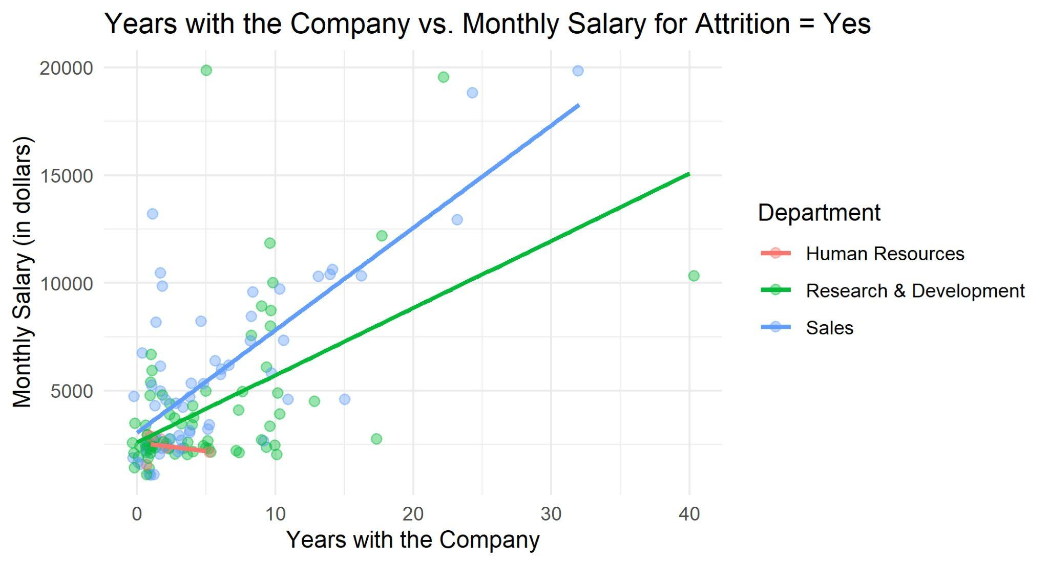
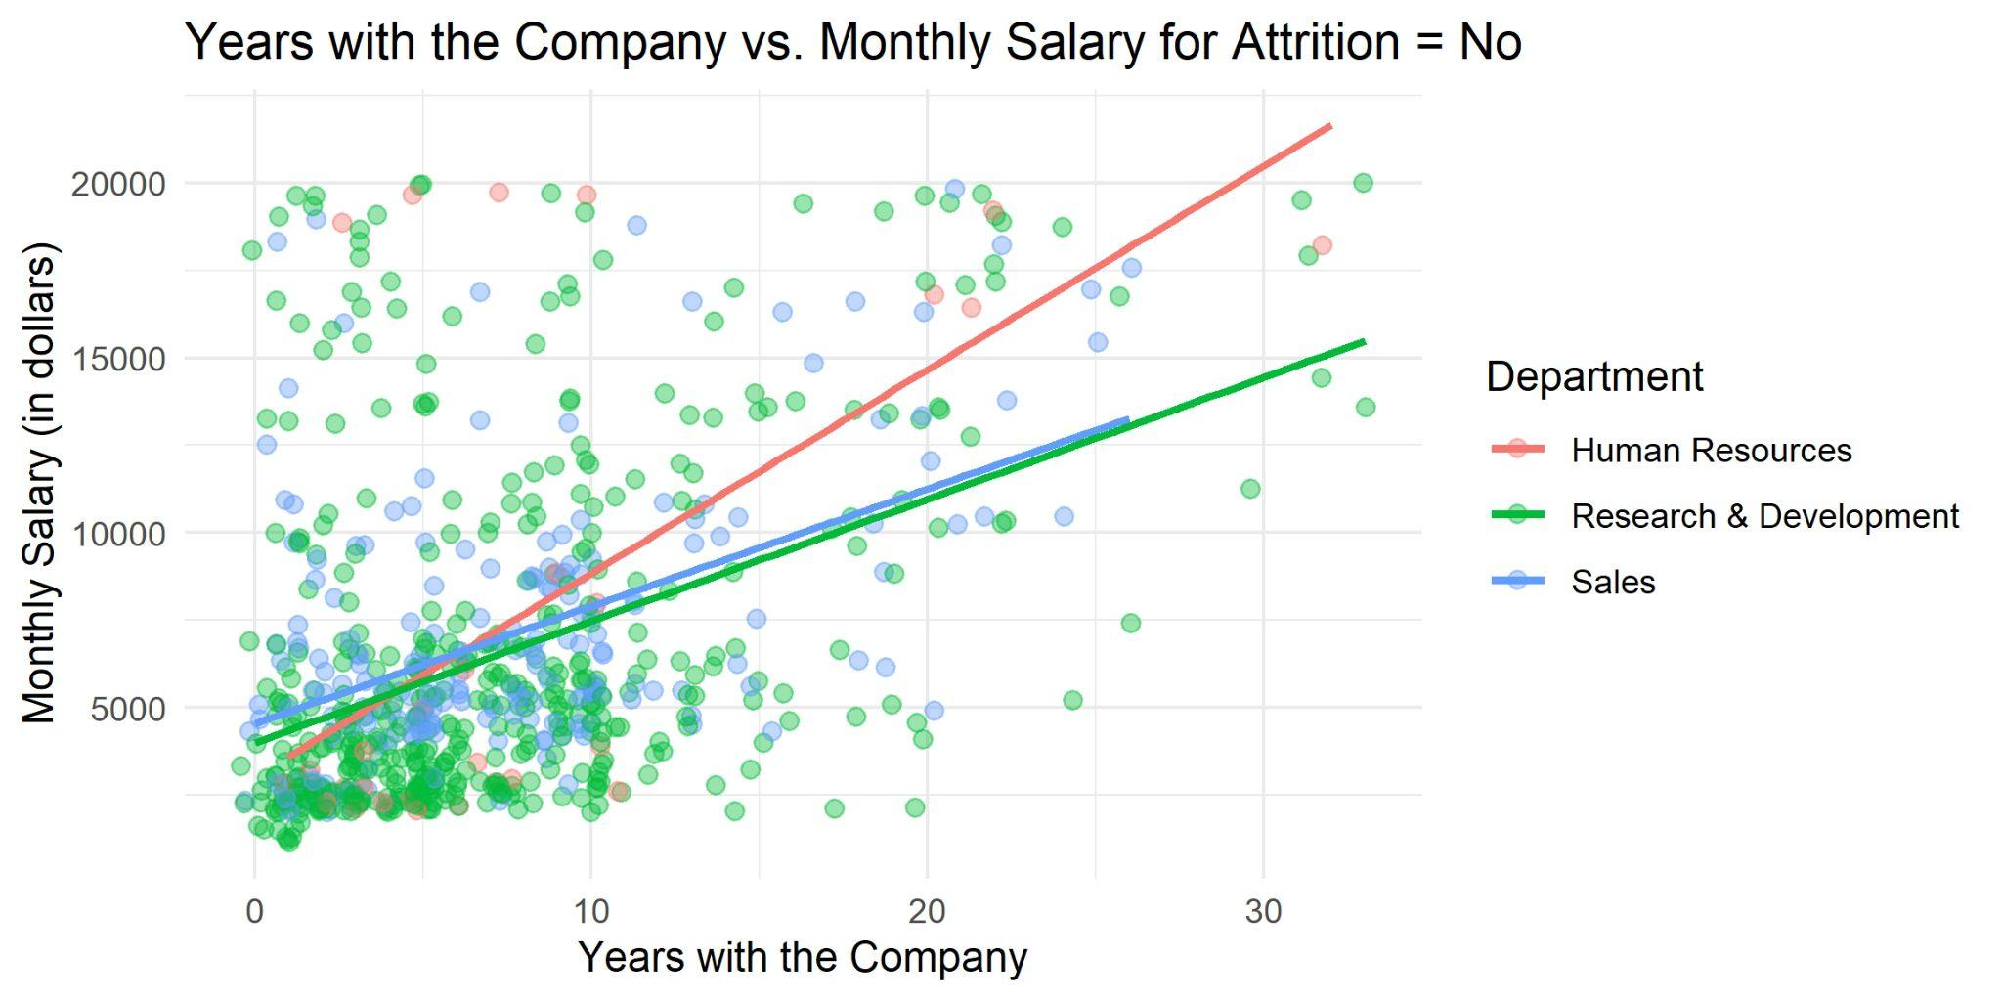
Years with Company vs. Monthly Income
We have a small sample size of employees in Human Resources.
Attrition Yes = Most earned less than $5,000 and worked less than 10 years at company.
Attrition No = Some employees earned more than $5,000 while working less than 10 years at company.

Slide 9
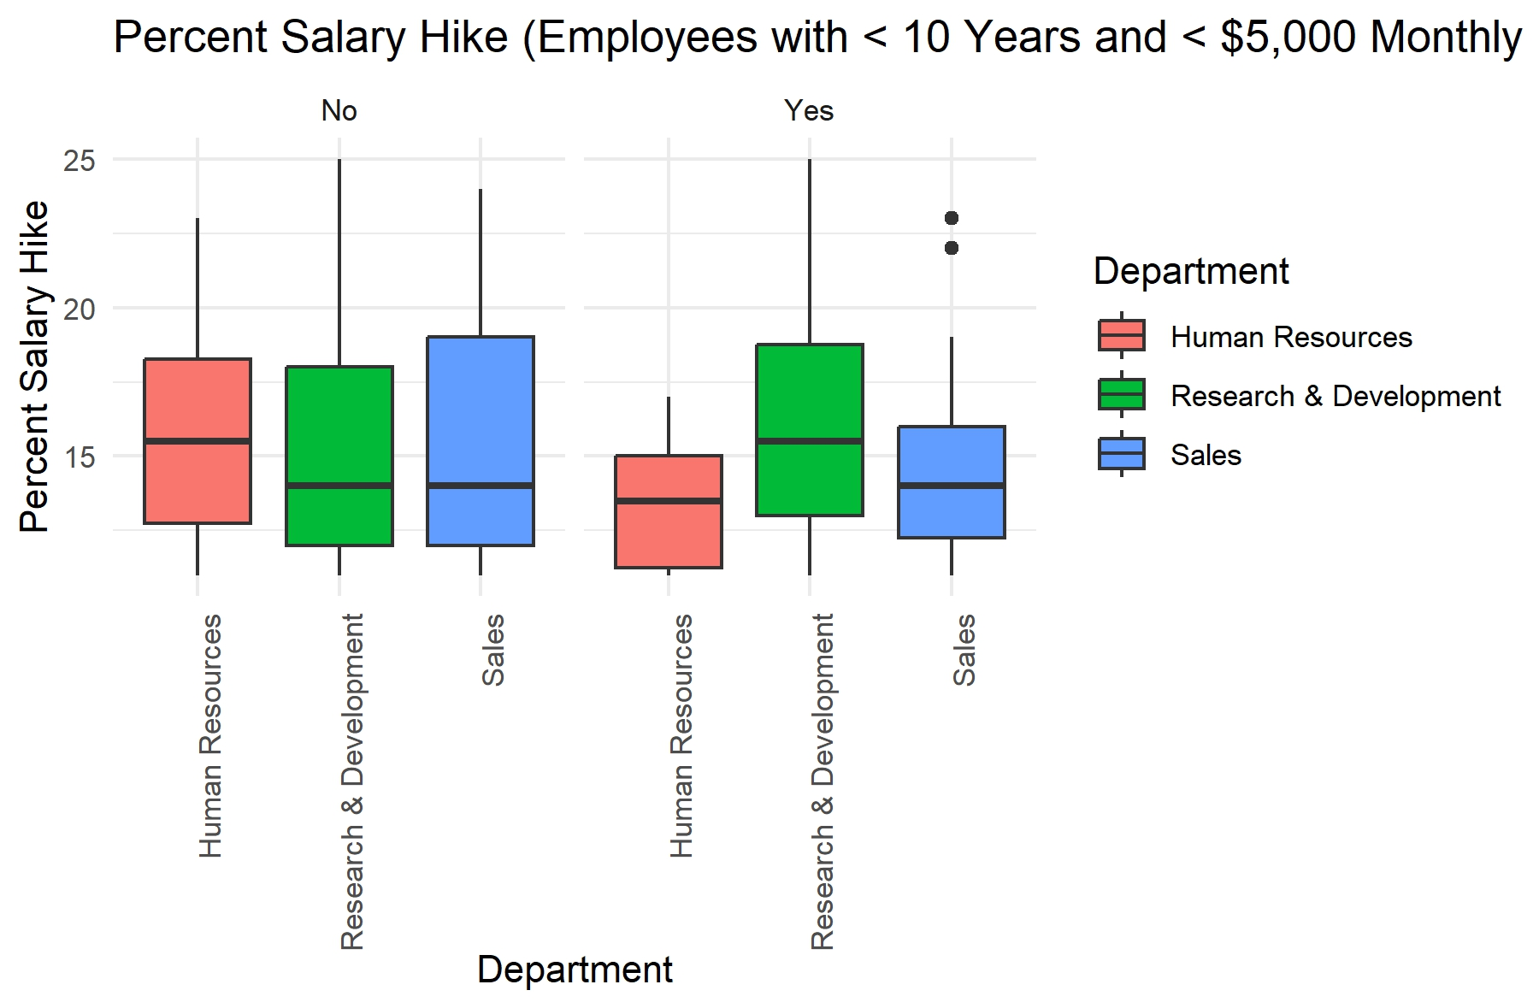
Percent Salary Hike
Employees that left Human Resources and Sales had lower percent salary hikes.

Slide 10
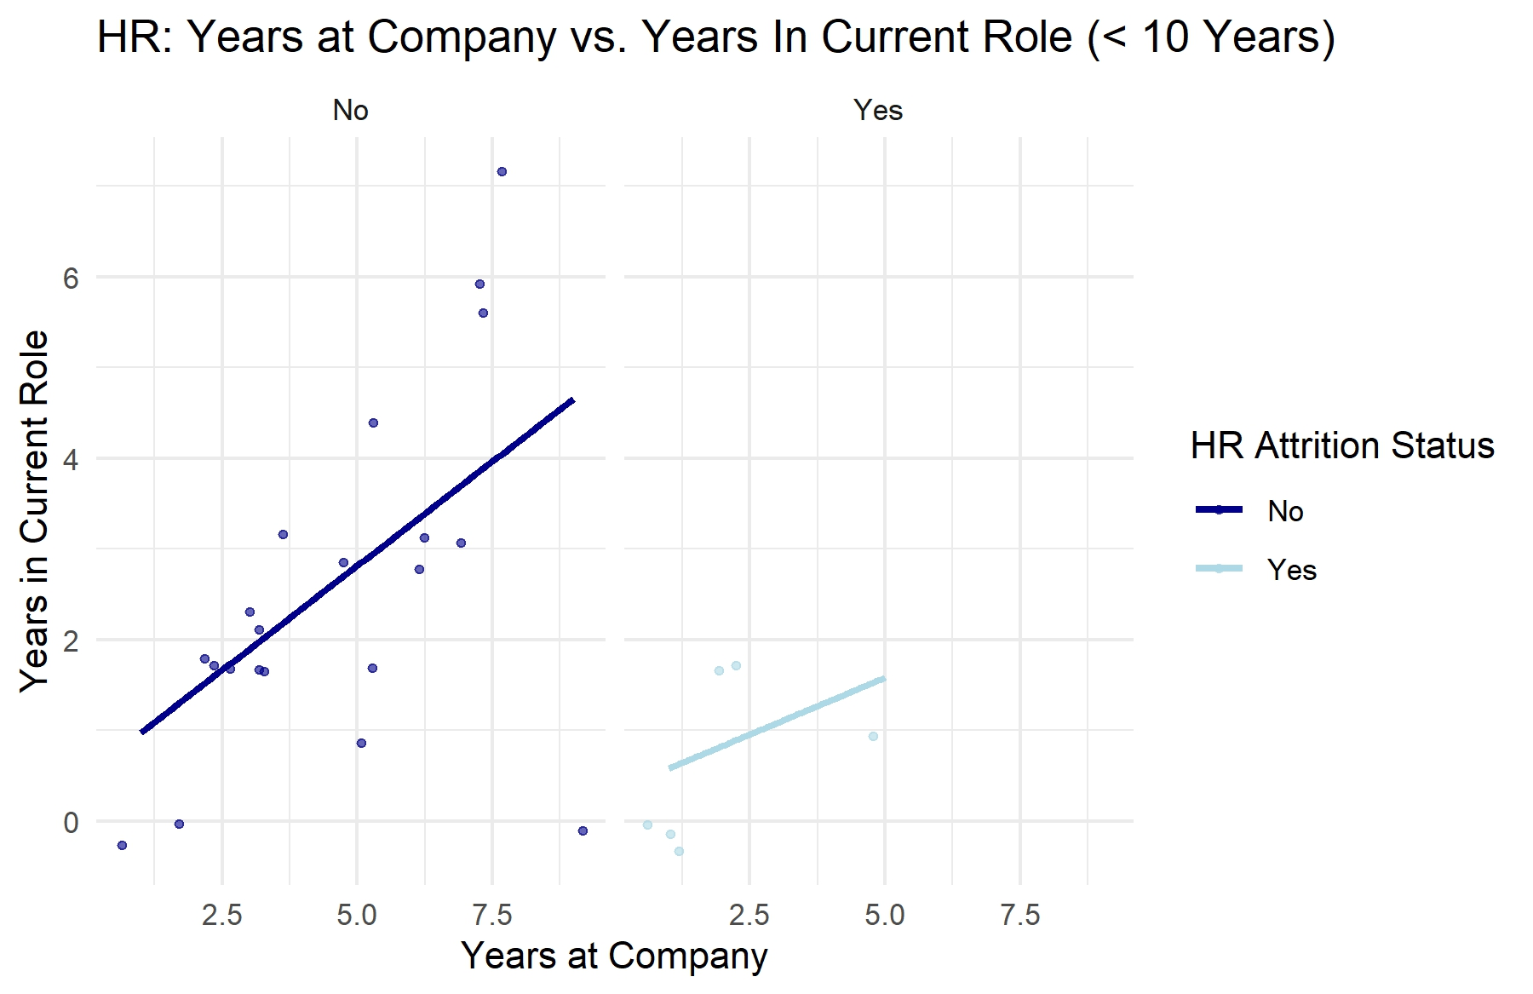
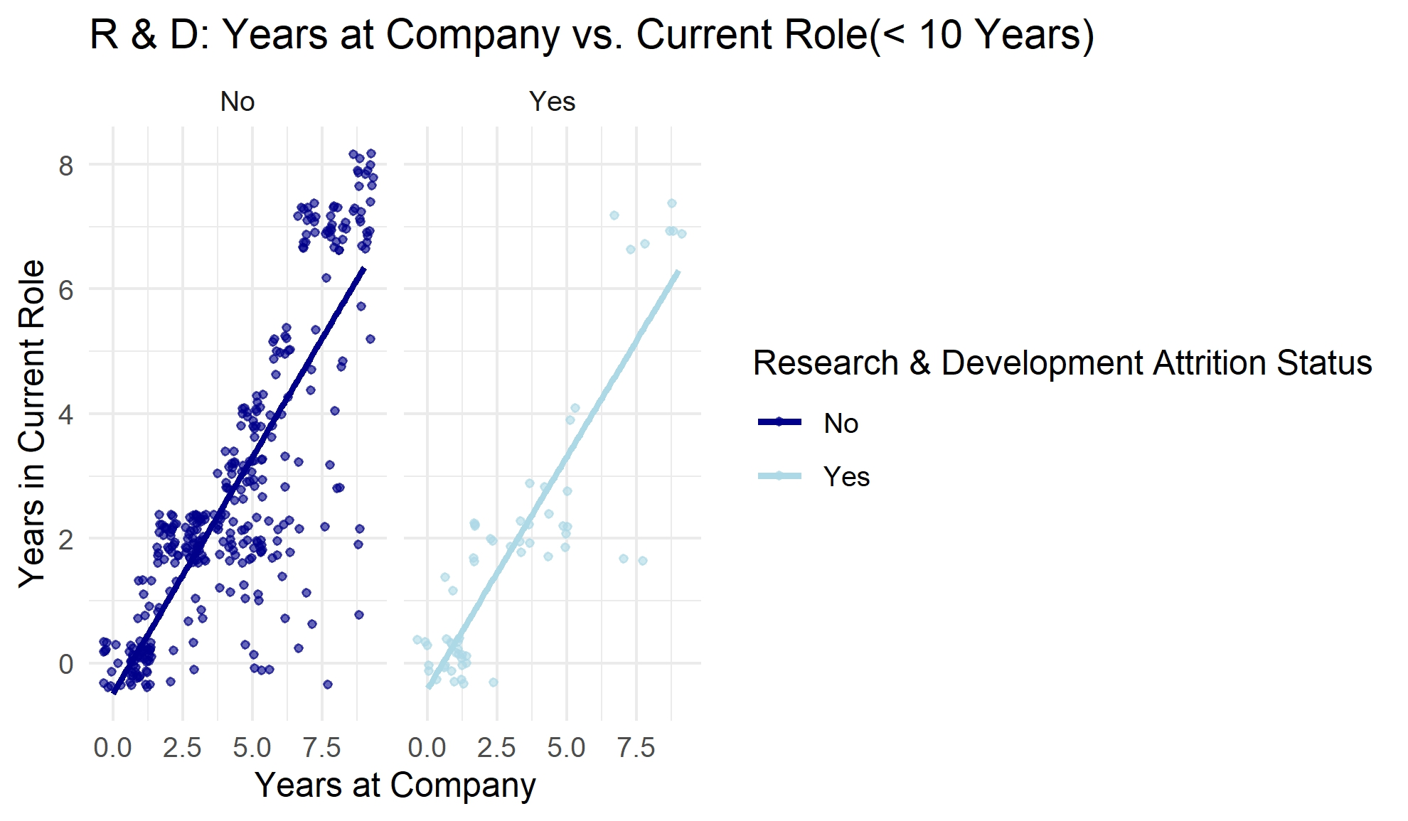
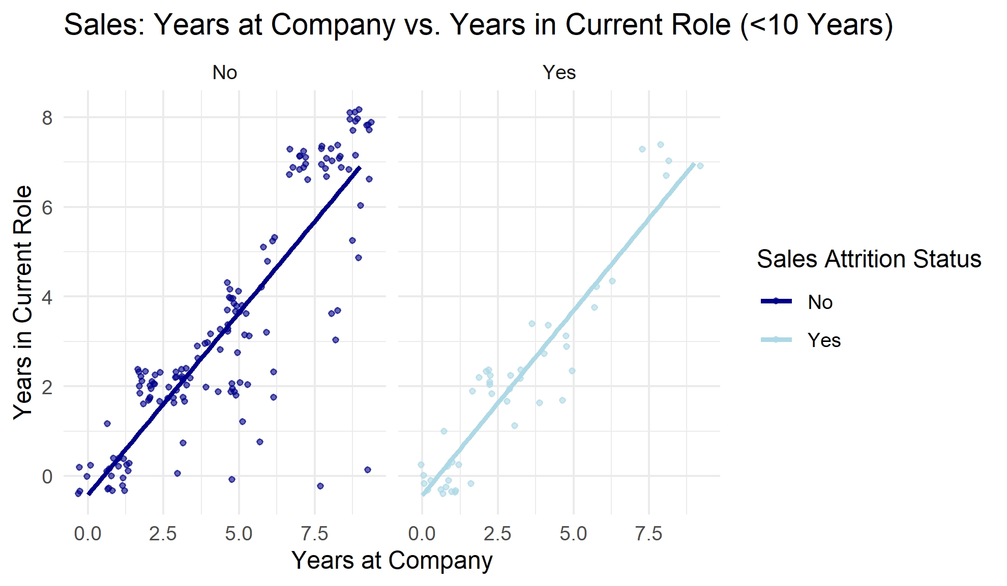
Years at Company vs Years in Current Role
Employees tend to spend a similar duration in their current role as they have overall with the company, indicating minimal role changes, despite attrition status.

Slide 11
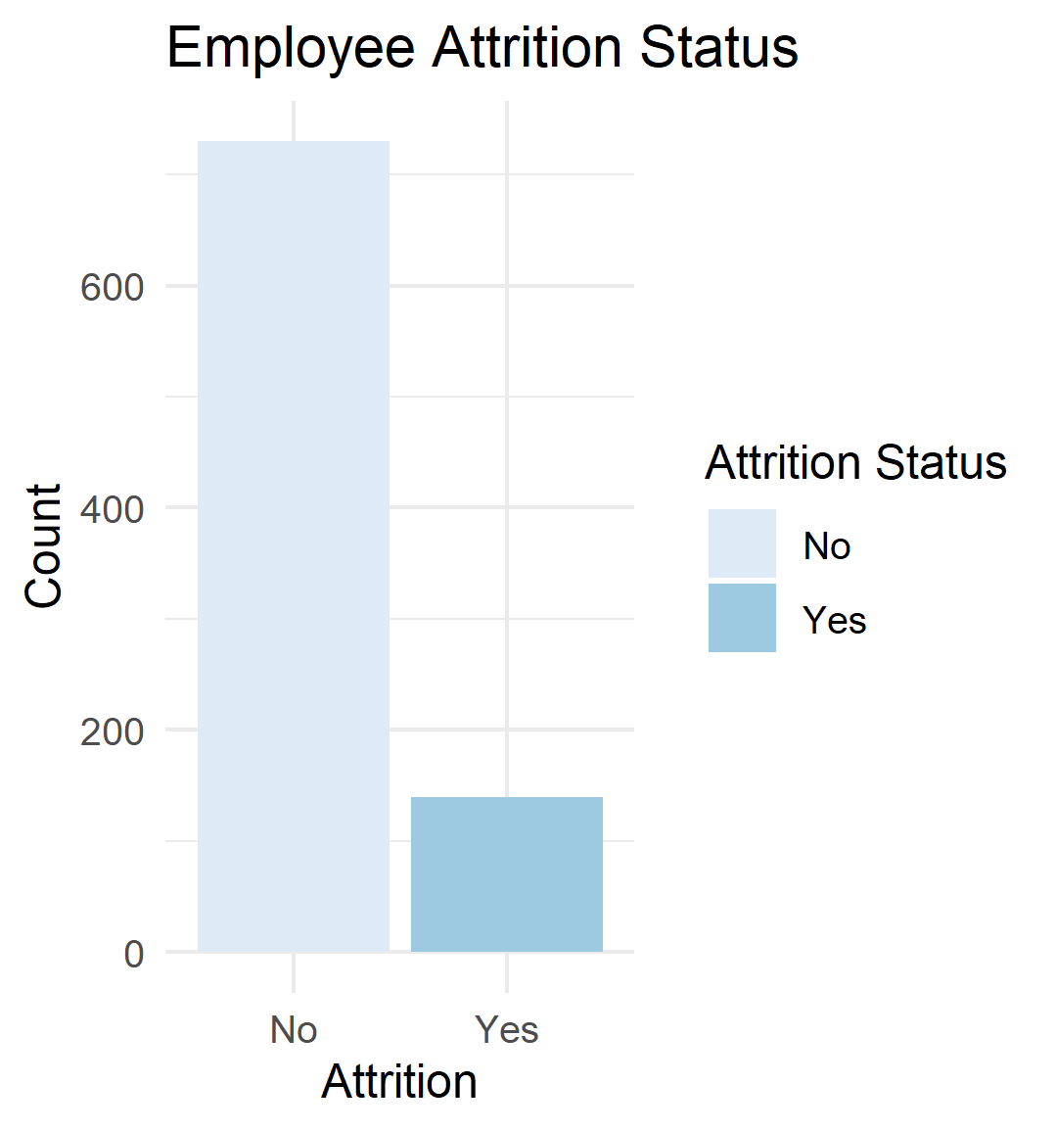
Classification Problem
The goal is to predict whether the employee will leave the company (attrition = yes) based on the following variables:
1. Monthly Income
2. Over Time
3. Percent Salary Hike
4. Years at Company
The positive class was set to “Yes” for the models.

Slide 12
K-Nearest Neighbors Model
Since there is an unbalanced dataset, adjustments were made to produce the following matrix:
KNN Confusion Matrix and Statistics (261 employees)
Positive Class = “Yes”
 | No (predicted) | Yes (predicted)
No (actual) | 139 (TN) | 16 (FP)
Yes (actual) | 80 (FN) | 26 (TP)
Accuracy = 63.22%
Sensitivity = 61.91%
Specificity = 63.47%
F1 = 38.21%
K =21,
70/30 Split = 609 observed in training set, 261 observed from test set
Undersampling = reduce majority class (attrition = no), improve focus on positive class (attrition = yes)
Threshold (0.50) = moderate, reasonable predictions
Precision (26.08%) = overpredicted employees leaving when they are staying
Moderate Recall (57.14%) : Decent prediction of those leaving that are indeed leaving (true positives).

Slide 13
Naïve Bayes Model
Since there is an unbalanced dataset, adjustments were made to produce the following matrix:
NB Confusion Matrix and Statistics (261 employees)
Positive Class = “Yes”
 | No (predicted) | Yes (predicted)
No (actual) | 138 (TN) | 9 (FP)
Yes (actual) | 77 (FN) | 37 (TP)
Accuracy = 67.05%
Sensitivity = 80.43%
Specificity = 64.19%
F1 = 40.24%
70/30 Split = 609 observed in training set, 261 observed from test set
Undersampling = reduce majority class (attrition = no), improve focus on positive class (attrition = yes)
Threshold (0.50) = moderate, reasonable predictions
Precision (27.78%) = overpredicted employees leaving when they are staying

Slide 14
Summary
Each department had less than 25% of employees leaving the company.
Overtime, monthly income, percent salary hike, years at the company are variables to consider for attrition.
Overall, the Naïve Bayes Model was a better model to use.

Slide 15
Questions?

Slide 16
Contact
Megan Huy, MSDS Student at Southern Methodist University
email: mhuy@mail.smu.edu

